Slide 1



Christmas in Spain

Slide 2
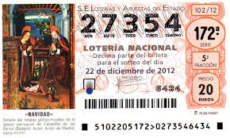
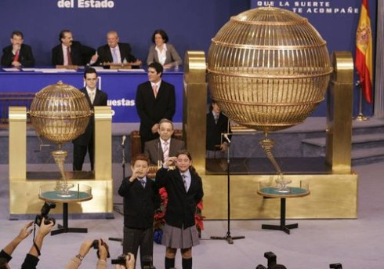
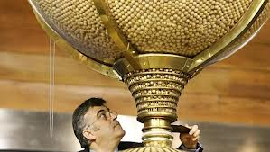
Christmas begins in Spain with the Sweepstakes traditional Christmas lottery on December 22.

Slide 3
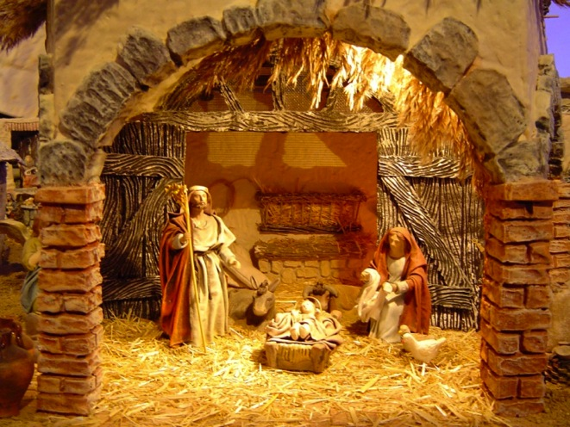
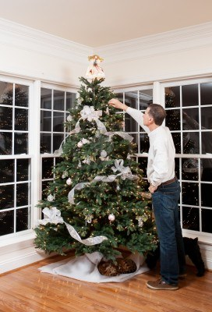
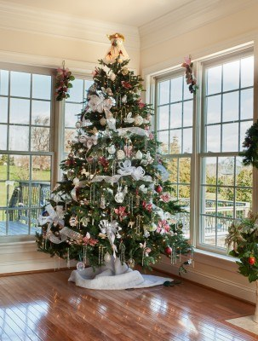
In Christian homes usually have a nativity or birth.
Also put Christmas trees, usually a small fir and decorated

Slide 4

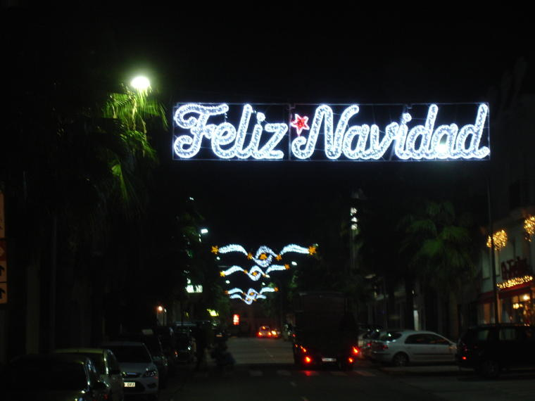
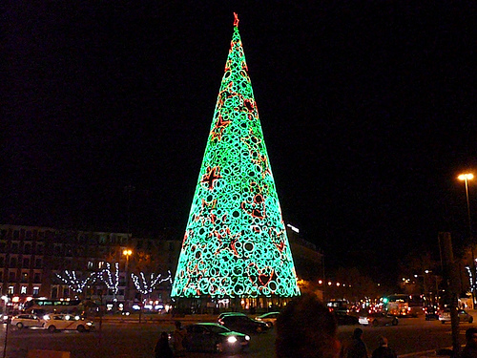
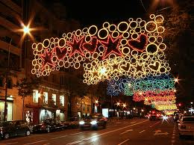
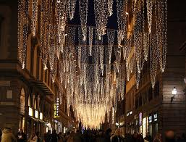
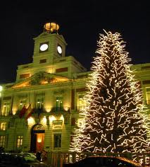
In the streets are placed lighting and bright and colorful Christmas trees large.

Slide 5
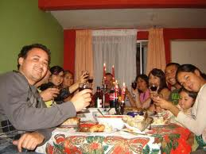
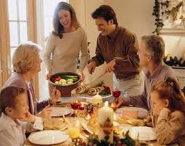
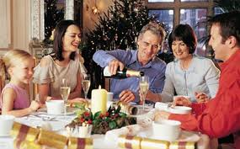
On the night of December 24, Christmas Eve is a family dinner, try to join the same family members scattered throughout the country or abroad.

Slide 6
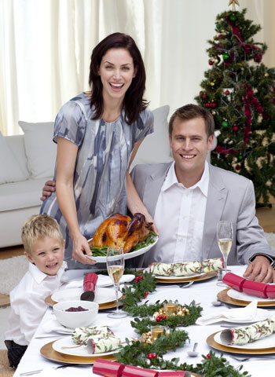
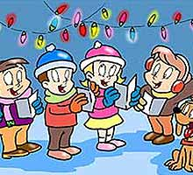
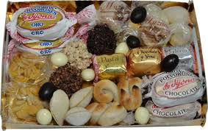
The most common is to dine stuffed turkey, shrimp and for dessert a tray on the table full of all kinds of nougat, marzipan, shortbread ...
Then sing carols.

Slide 7
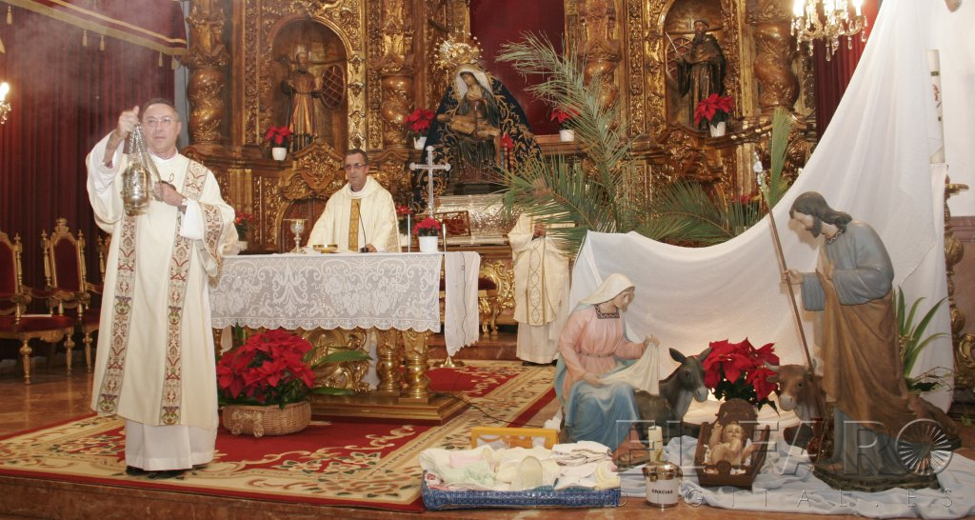
On Christmas Eve we celebrate the "Midnight Mass". According to tradition, this animal was the first to witness the birth of Jesus and announce it to the world. It was common for family members to attend together this midnight mass.

Slide 8
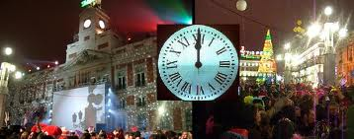
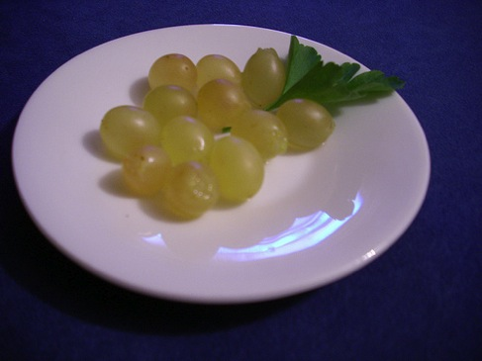
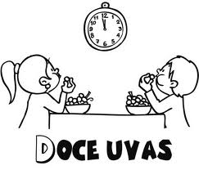
On 31 December at 00:00 hours eating 12 grapes in time with the 12 chimes of the clock of Puerta del Sol is said that if you can eat all the grapes on time and choke on, you're lucky the 12 months of the year.

Slide 9

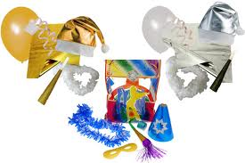
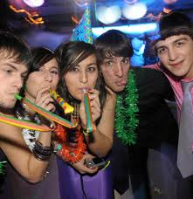
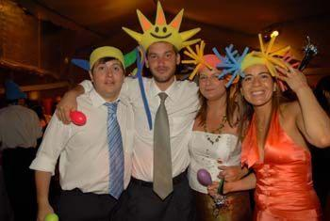
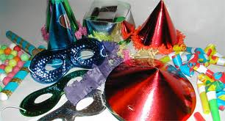

Then, many people enjoy the night in a dance party called “cotillón“

Slide 10
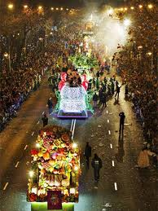
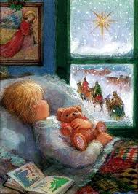
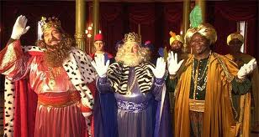
Spanish Christmas comes to an end with the arrival of the Three wise men. On the night of January 5, after attending the Cavalcade of the Three wise men, all children leave their shoes in a visible place in the house, and go to sleep with the hope of awakening and discover the gifts they have left Melchor, Gaspar and Baltasar.

Slide 11
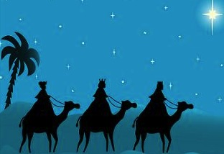
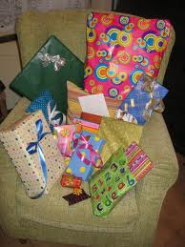
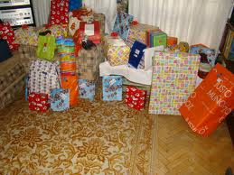
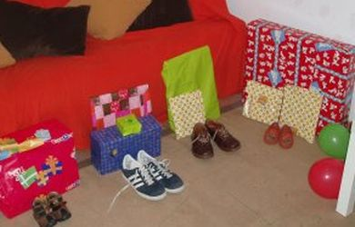
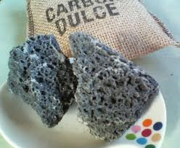
On day 6 the smallest rush to see what they have brought the Three wise men. To those who have misbehaved sometimes leave them sweet coal.

Slide 12
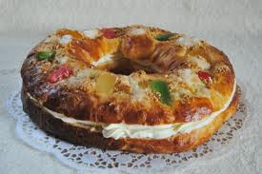
For breakfast or after dinner, the family takes the typical sweet this day: the roulade of “Reyes”, a type of thin-crust bun ring-shaped and decorated with pieces of candied fruits, symbolic of rubies and emeralds that adorned the colorful robes of the Three wise men. Among the mass lies a little surprise and whoever finds it is crowned king of the house.

Slide 13
MADE BY:
GUILLERMO DOYAGUE
JUAN GARCÍA

